Slide 1
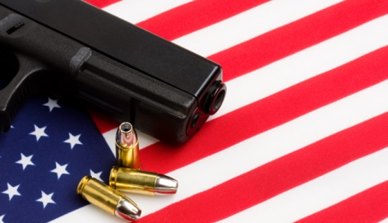
Mass Shooting in US
Samriddhi Shakya

Slide 2
Definition of Mass Shooting
A mass shooting is an incident involving multiple victims of gun violence
FBI derived definition: FOUR or more shot and/or killed in a single event [incident], at the same general time and location, not including the shooter.
According to the Gun Violence Archive, a “mass shooting” is any incident where four or more people are wounded or killed.
According to Stanford University database definition, mass shooting is incident with 3 or more shooting victims (not necessarily fatalities), not including the shooter. The shooting must not be identifiably gang, drug, or organized crime related.
While the U.S. has 5% of the world’s population, it had 31% of all public mass shootings. These gun statistics are quite alarming and the country really needs to act to alleviate the problem.

Slide 3
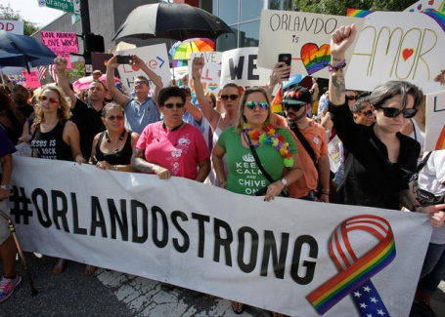
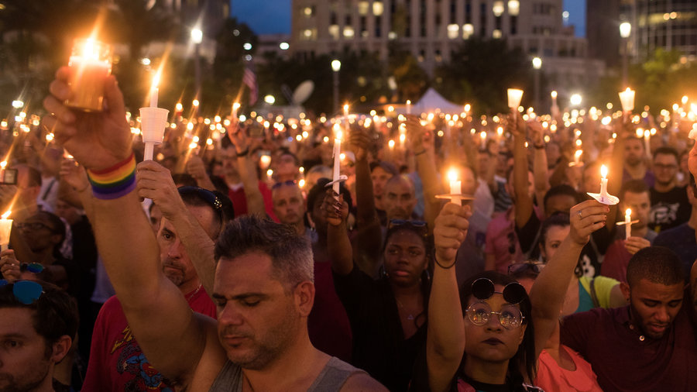
Orlando Mass Shooting
On June 12, 2016, United States suffered the worst mass shooting in its modern history when 50 people were killed and 53 injured in Orlando, Florida, after a gunman stormed into a packed gay nightclub

Slide 4
Questions?
Occurrence of Mass shooting by state (1966 -2016)
Mass Shooting Deaths and injuries by State (1966 -2016)
Which guns have been used more commonly during the mass shooting (1966 -2016)
Which race and sex was more involved in mass shooting (1966 -2016)
Which type of place was targeted more for mass shooting (1966 -2016)
Comparison between Mass shooting data from 2014 and 2016

Slide 5
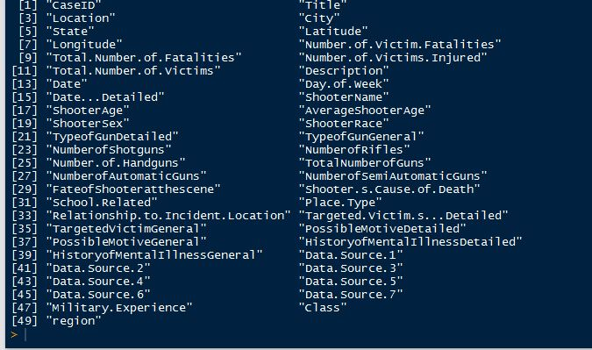
Data Source Used
Stanford University Library MSA
Gun Violence Archive

Slide 6
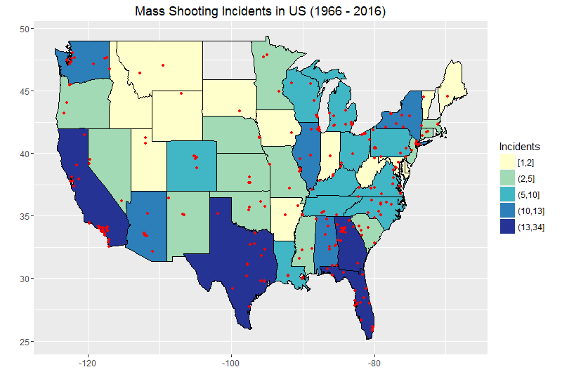

Slide 7
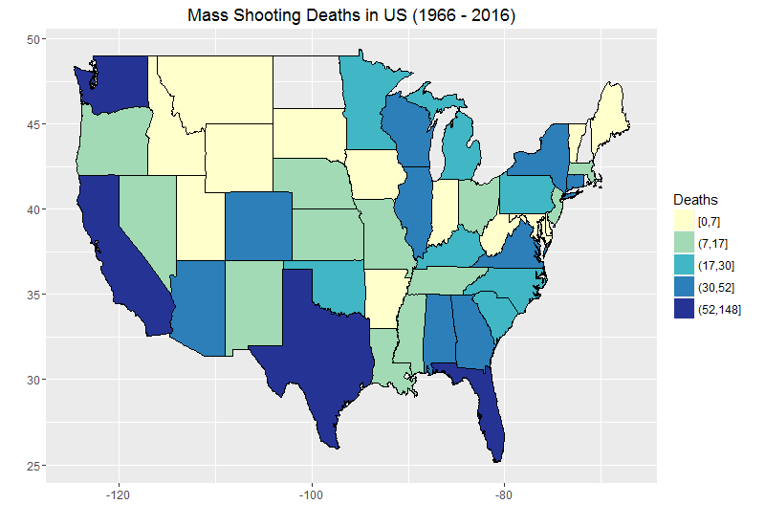
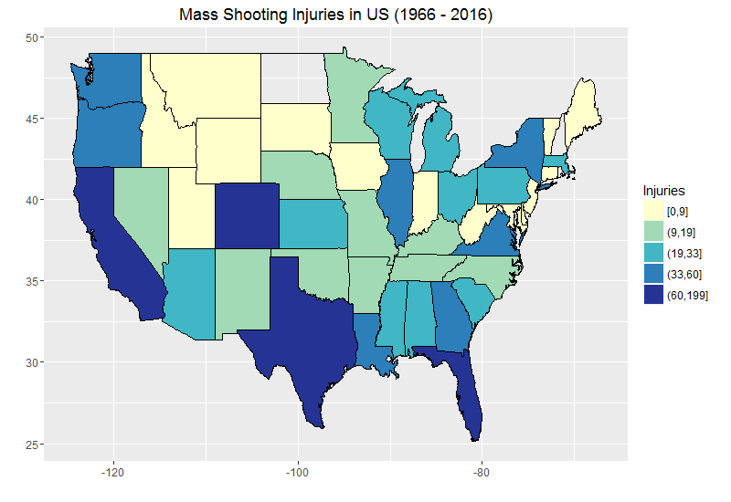

Slide 8
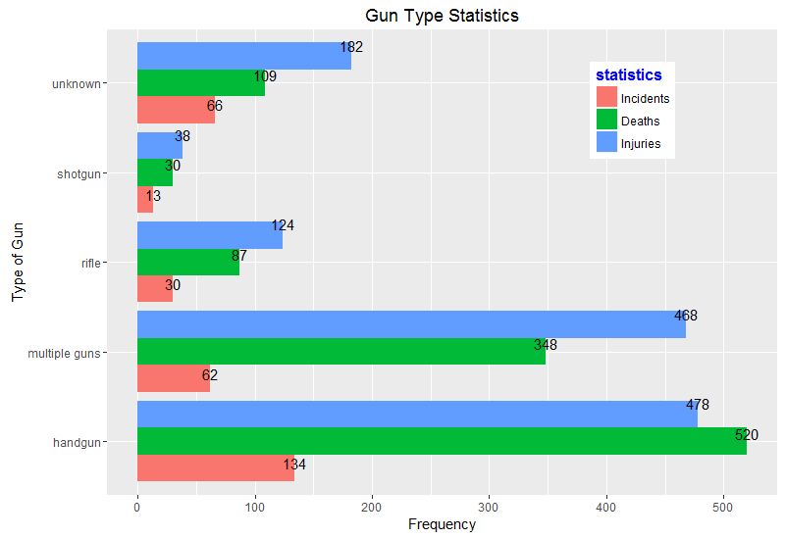

Slide 9
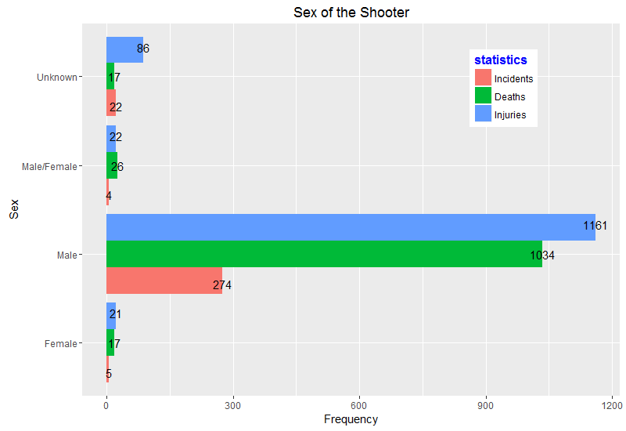

Slide 10
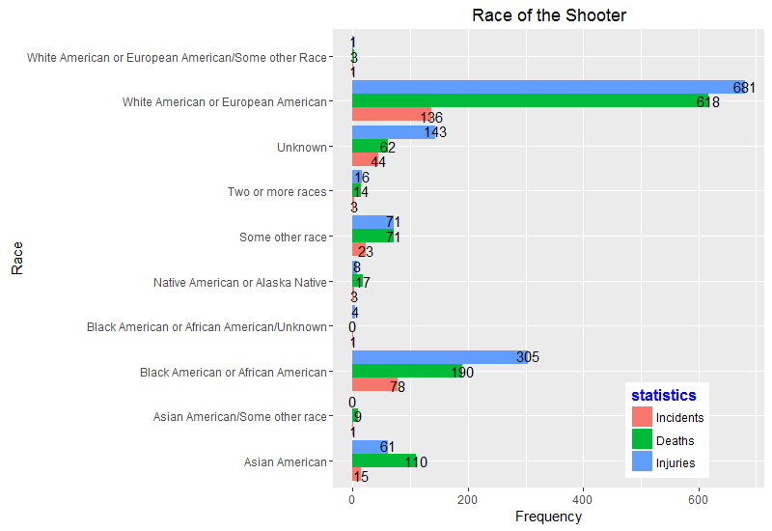

Slide 11
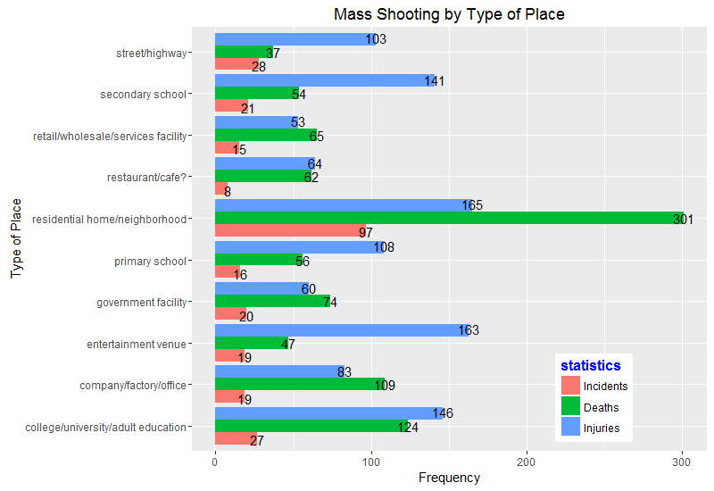

Slide 12
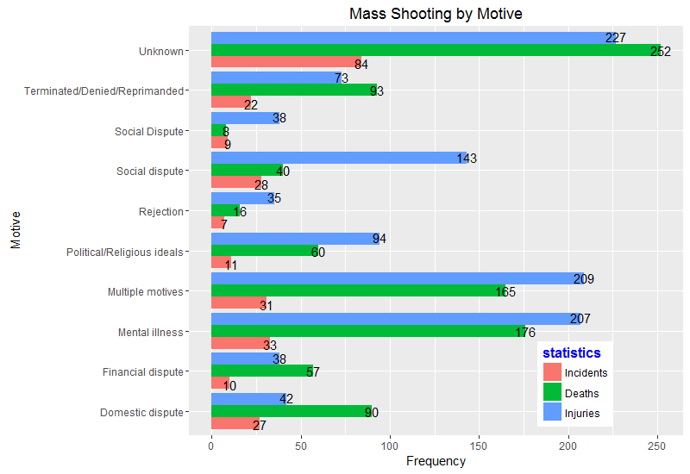

Slide 13
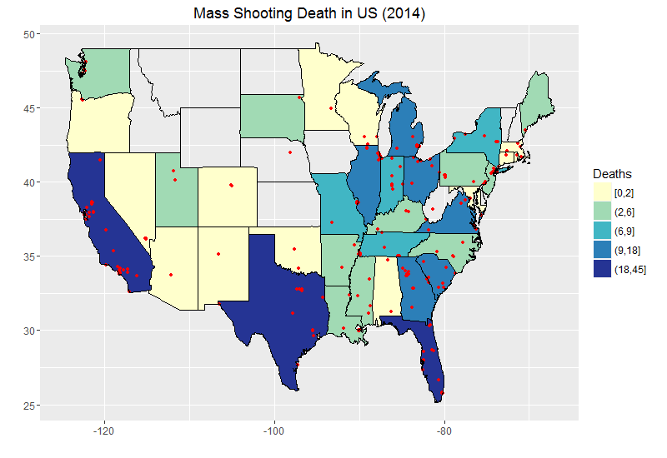

Slide 14
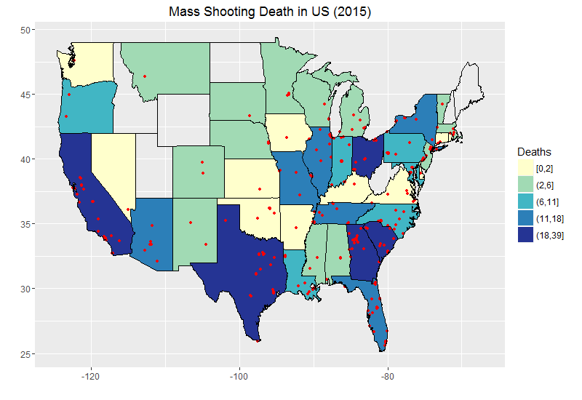

Slide 15
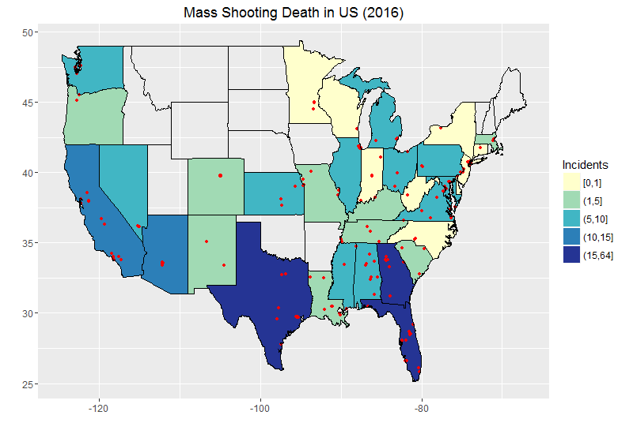

Slide 16
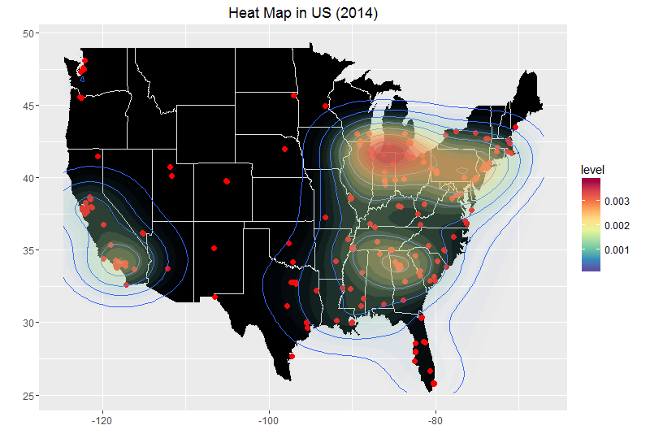

Slide 17
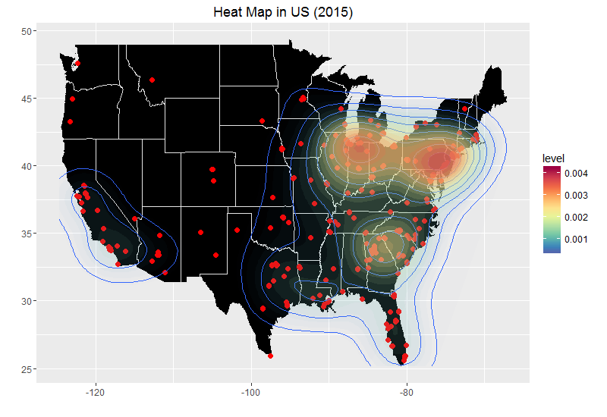

Slide 18
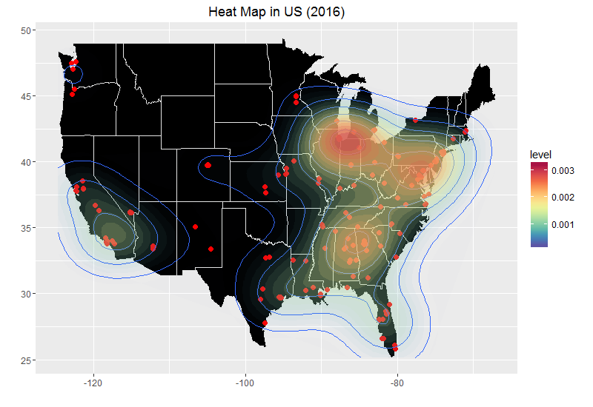

Slide 19
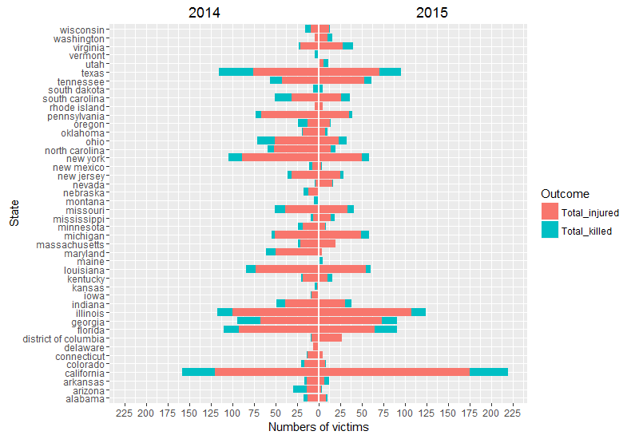

Slide 20
Conclusion
Mass shooting incidents in California, Florida, Georgia and Texas are very high with high number of fatalities and injuries.
The type of gun which the shooters commonly used was handguns followed by multiple guns in most of the mass shooting incident.
The shooters were predominantly male with most of them belonging to White Americans or European American race.
The reasons behind most of the shooter’s motives were unknown followed by mental illness.
Most of the mass shooting commonly occurred in residential and neighborhood areas.
Comparing the recent mass shooting data from 2014 to 2016, we can notice that there are more mass shooting in States like California, Georgia, Illinois and near Maryland.
Comparing 2014 and 2015 data, there were more mass shooting and fatalities in 2015 than 2014.

Slide 21


